Slide 1

THE EFFICIENT TASK SCHEDULAR !
Sagar Mane:- 23106032
Rajanya Kshatriya:- 23106096
Bhagya Gandhi:- 23106101
Aditya Khande:- 23106098
Project Guide
Ms.Nirali Arora
Academic year 2024-25
Notes:
1

Slide 2
Introduction
It aims to provide a user-friendly and efficient solution for personal task management.
To address the common challenges individuals face in organizing and prioritizing their tasks effectively.
From task scheduling to progress tracking, “The Efficient Task Scheduler" aims to be your ultimate companion in staying organized and focused.
Notes:
2

Slide 3
OBJECTIVES:
The primary objectives of this project are to:
Design an Efficient Scheduling Algorithm: Implement an algorithm that schedules tasks based on their priority and deadlines to ensure optimal performance and adherence to constraints.
Create a User-Friendly Interface:
Ensure Scalability:
Provide Robust Error Handling
Notes:
3

Slide 4


MOTIVATION:
Usually we decide our day goals in the morning when we wake up but when we are with friends or family we don’t know how time flies quickly, and that day is gone but our goals for the day remains incomplete.
So we will make a web in which we decide goals for that day , the show bar in web will continuously showing our progress in goal completing and reminding us.
Notes:
4

Slide 5
LITERATURE SURVEY OF EXISTING SYSTEM
The research of scheduling algorithms in real-time system.
A Study on Different Types of Scheduling Algorithm.
The paper compares several kinds scheduling algorithm
Each algorithm has some advantages or disadvantages . In order to take all the factors ,the paper put forward a new operating system scheduling algorithm median-time slice-Highest Response Ratio Next, the method was proved to be feasible and effective after tested the five process sequence.
Notes:
5

Slide 6

Problem statement
"To develop a Javascript-based task management application, ‘Efficient Task Scheduler,' that empowers users to efficiently organize, prioritize, and track their daily tasks, enhancing productivity and time management skills."
Key Features Showcase
Task creation and organization
Priority management and categorization
Deadline tracking and reminders
Progress monitoring and reporting.

Slide 7
Overview of System Design
Homepage Components:
Login page.
Welcome Message.
Summary of Tasks.
Task List with different categories.
Add a new tasks.
Set Remainders to get notifications.
Notifications.
Notes:
7

Slide 8
Technology Stack
Frontend:
Javascript: For building the graphical user interface (GUI) in Javascript, offering rich UI components and platform independence.
Backend:
Java: Backend logic and business rules implemented in Java, ensuring robustness and compatibility.
Database:
SQLite: Lightweight, embedded relational database for storing user data, tasks, and settings.
Notes:
8

Slide 9
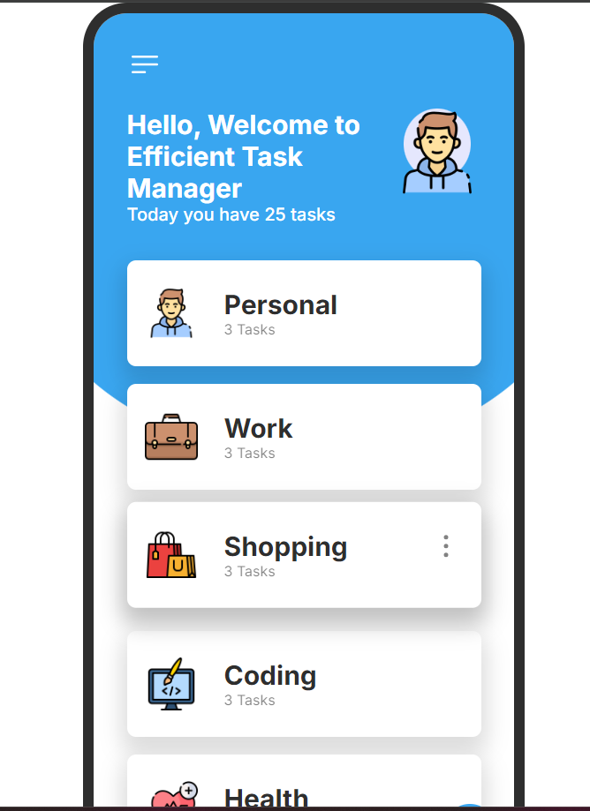
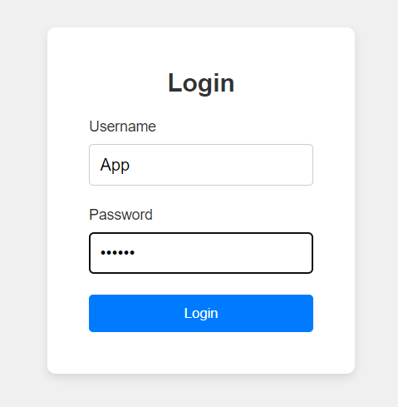
IMPLEMENTATION
Notes:
9

Slide 10
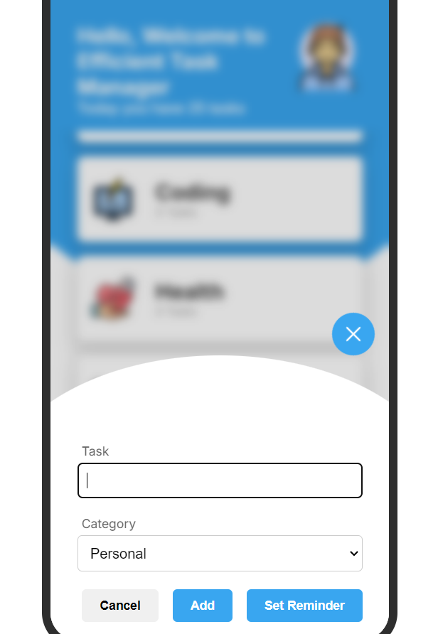
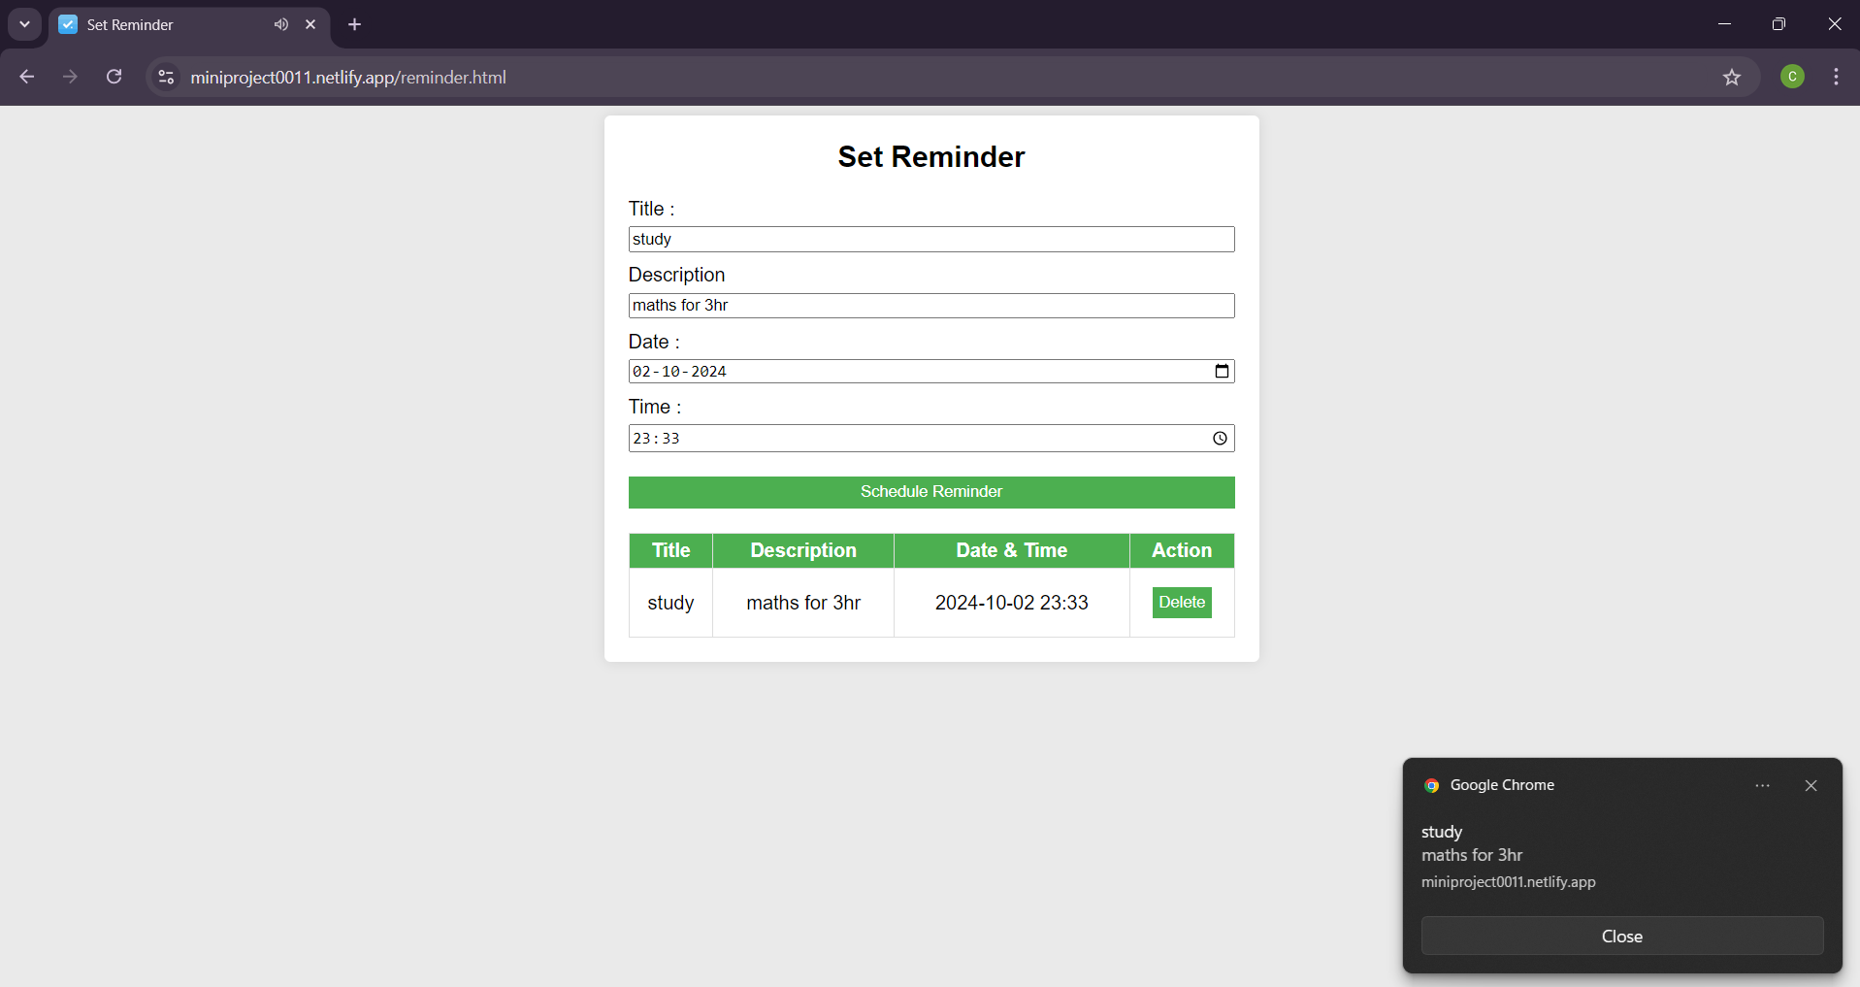
IMPLEMENTATION

Slide 11
LIMITATIONS:
Performance: As the number of users or tasks grows, performance may degrade if the website is not optimized to handle large data sets or high traffic volumes.
Search and Filter: Basic implementations might lack advanced search, filtering, or sorting capabilities, which are necessary for managing a large number of tasks efficiently.
Basic Error Handling: Many to-do list websites lack comprehensive error handling, leading to potential crashes or unexpected behaviour if users input invalid data.
Insufficient Input Validation: Without proper validation, users may enter incorrect or malicious data, which can compromise the website's stability or security.
Notes:
11

Slide 12
CONCLUSION
SUMMARY:
Our mini-project has successfully developed a functional Efficient task manager website that demonstrates key aspects of task management and web development.
This project pave the way for future improvements and advancements.
Notes:
12

Slide 13


REFERENCES
For Error Handling
Use W3 schools website
https://www.w3schools.com/js/.
Research Papers and Articles:
"A Survey of Task Scheduling Algorithms in Cloud Computing"
"Task Scheduling Algorithms: A Survey"
"Dynamic Scheduling Algorithms for Real-Time Systems: A Survey“
Notes:
13

Slide 14

Thank You...!!
Notes:
14

